Slide 1
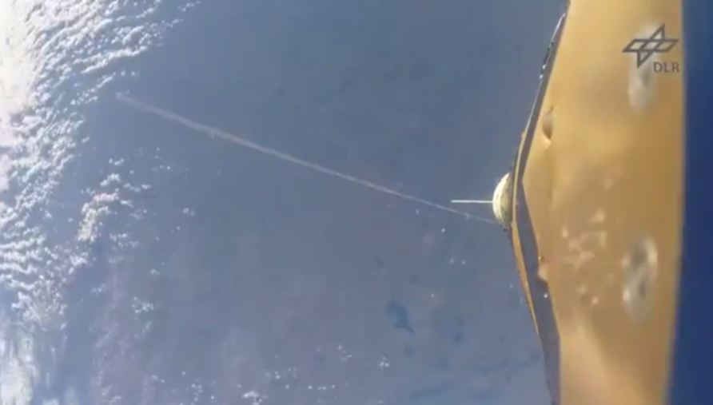
Yo-yo despin weight deployed from
a sounding rocket.

Slide 2
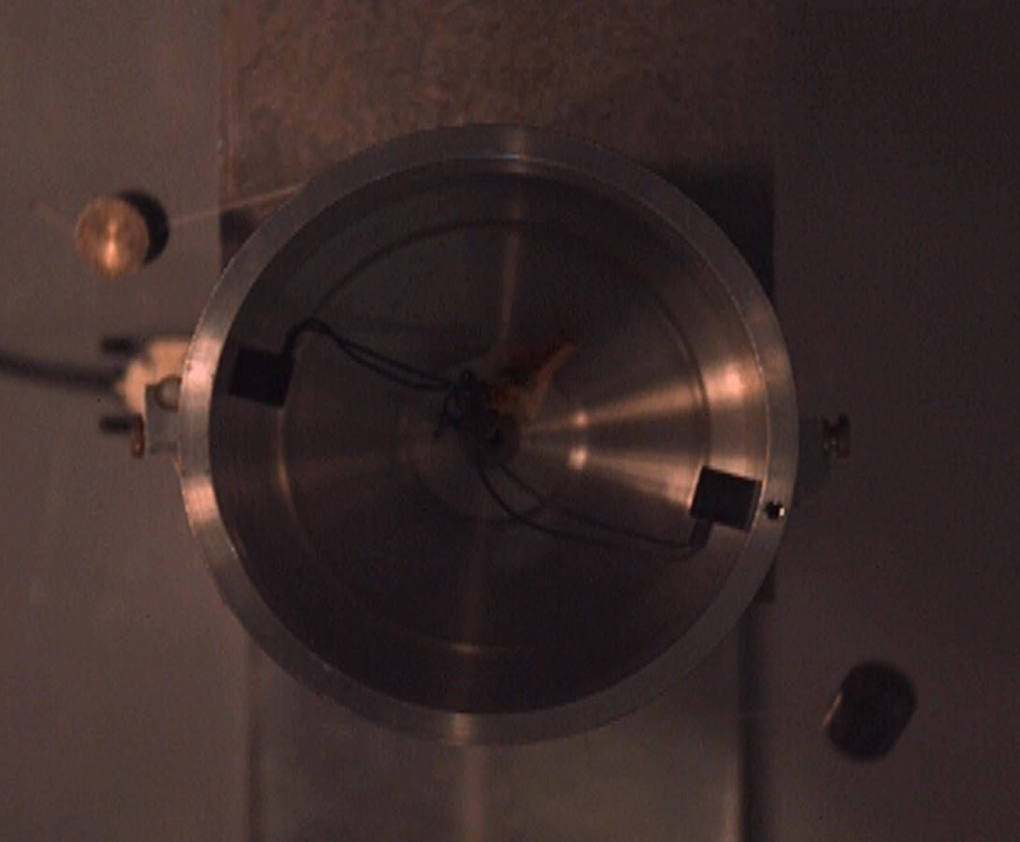

Satellite Body
Tether String
De-Spin Mass
$$ω$$
Electromagnetic Release Mechanism
Attachment Mechanism
Encoder Housing / Motor Connection
Nylon Capture Ball
Radial Vector
Nylon Capture Ball
Attachment Mechanism
Tether String
De-Spin Mass

Slide 3
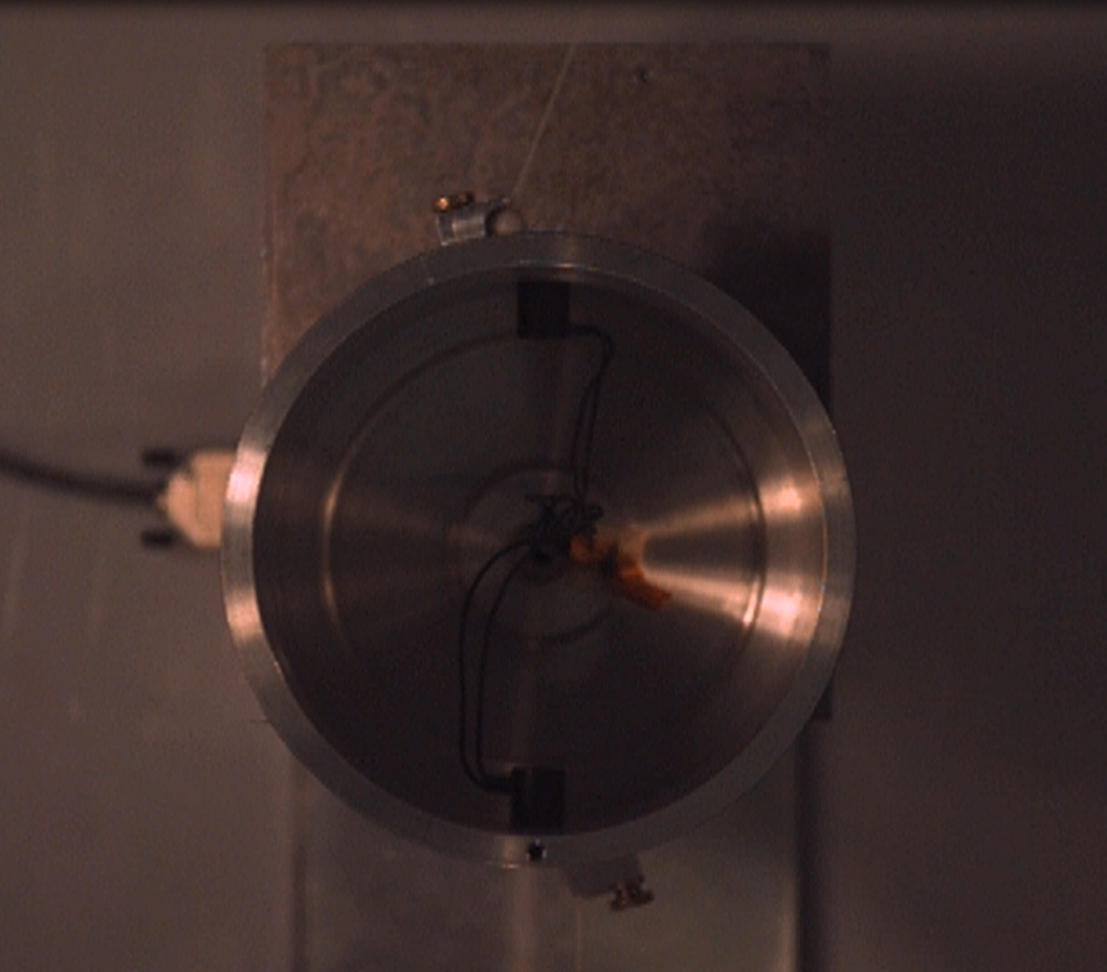
Angular Displacement past radial release
Radial Vector
Angular Displacement past radial release

